Slide 1

5596 -Data Analytics
R for Marketing
Group 5: Adrian Lehrner, Pascal Jakub Schreiber, Henriett Kapui, Marta Wiśniewska, Sebastian Frey

Slide 2

Table of content
Motivation and research question
Dataset
Summary
Models and model evaluation
Classification: KNN and Naïve Bayes
Linear regression
Regression trees and random forests
Model comparison and results
Regression tree, Linear regression vs. Random Forests
Discussion and comments
Correlation matrix/PCA

Slide 3

Motivation and research question
Income prediction for marketing purposes
Importance of income predictors such as: Education, Marital Status, Age
What is the estimated income of customers who did not state it?​

Slide 4

Our data
Summary
Our dataset consists of customer’s data collected since their enrollment with the company.
Source:
https://www.kaggle.com/datasets/rodsaldanha/arketing-campaign
Size: 220 KB
Format: CSV
Variables: 2240 Rows x 29 Columns
Pre-processing:
Removing attributes not related to customers
Creating new columns
Splitting to train and test

Slide 5
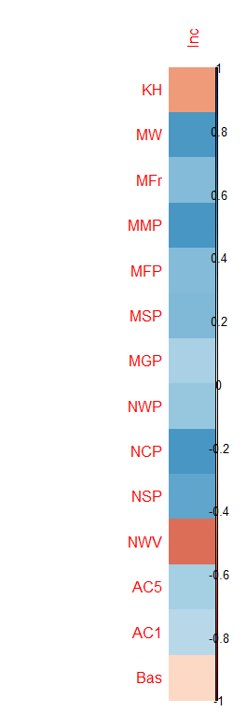
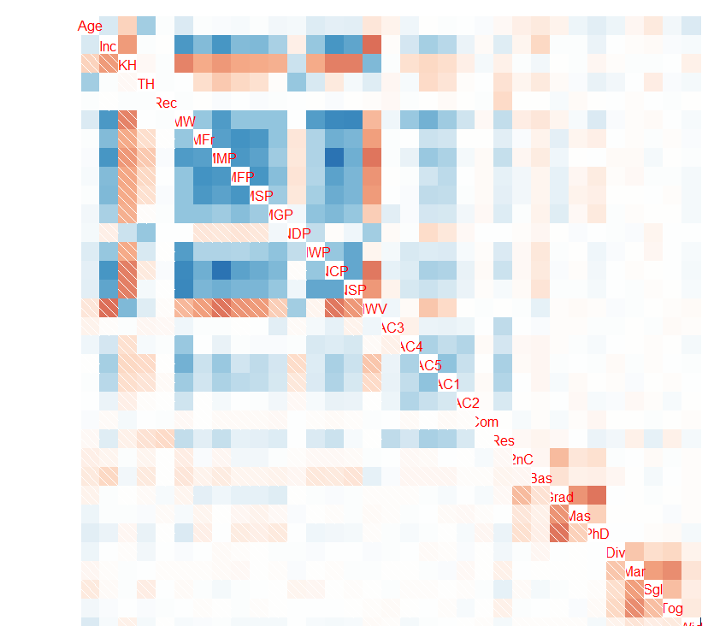

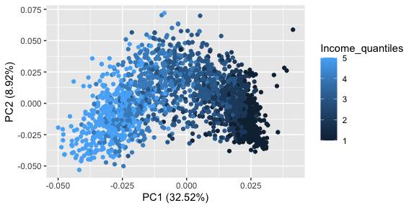
PCA, Correlation matrix
Only variables with a Correlation > 0.2 are considered
PCAs vs. 5 Income quantiles
Income
Interpretation might not be that straight forward/intuitive for some of the variables but it does appear reasonable that Gold purchases and Wine purchases correlate positively with Income while Basic education has a negative effect
KidsHome
Lets simplify
MntWines
MntFruits
MntMeatProducts
MntFishProducts
MntSweetProducts
MntGoldProducts
NumWebPurchases
NumCatalogPurchases
NumStorePurchases
NumWebVisitsMonth
Accepted Cmp5
After reducing the complexity of the data through PCA a clear pattern of different subgroups regarding income is visible
Accepted Cmp1
Basic education

Slide 6
Comparing data via a classification approach
KNN
Naive Bayes
Overall better performance of KNN
If income is split into a binary variable accuracy of 91%
If income is split into 5 quantiles reduction of accuracy, but still accuracy of 73%
Naive Bayes approach is worse than KNN in every metric except precision, here they are approximately equal
KNN is preferable over Naive Bayes

Slide 7
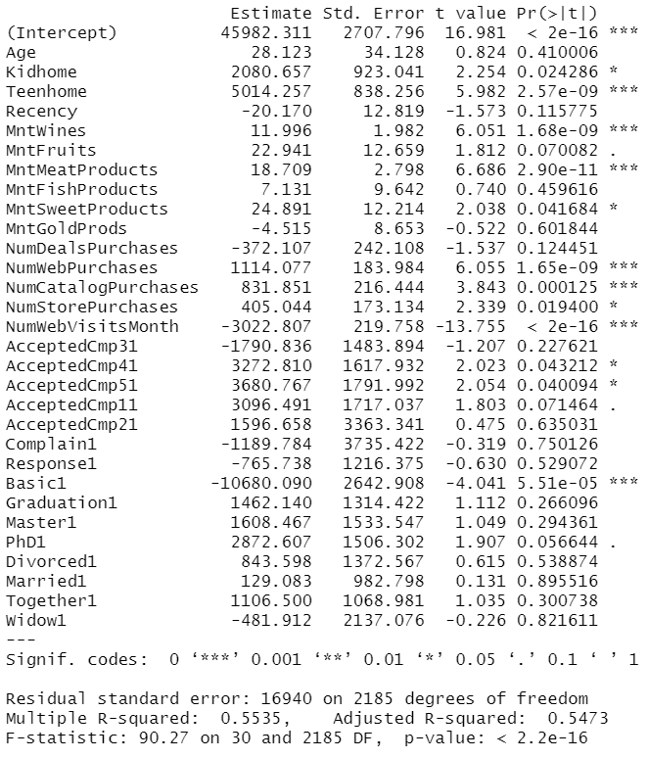
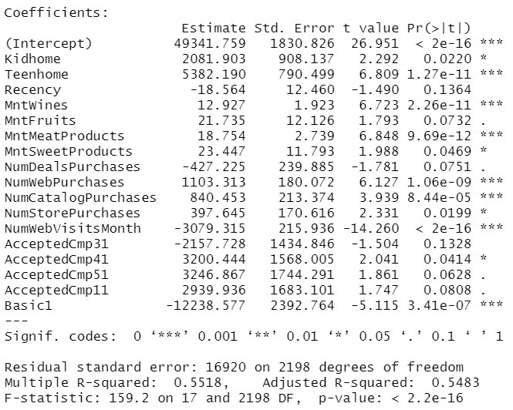
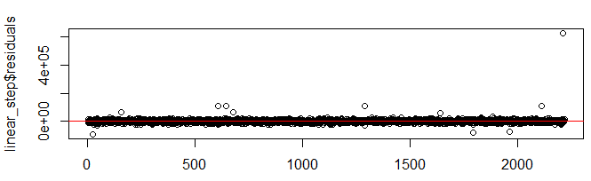
Linear Regression
Full model with all variables
Stepwise model by AIC

Slide 8
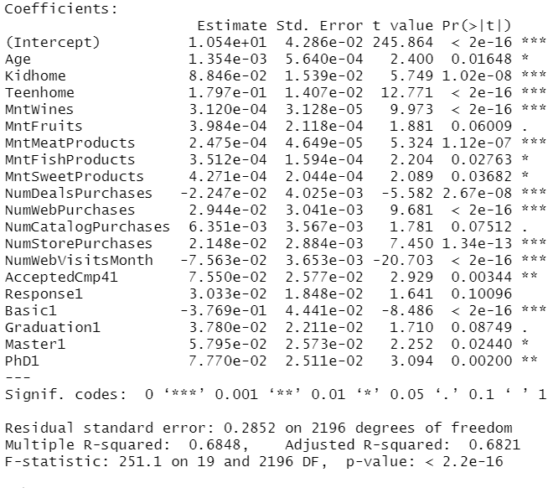
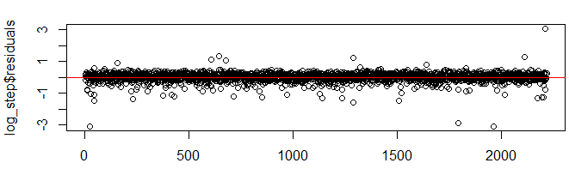
Linear Regression
Log-Linear Stepwise model by AIC
Comparison test/train set
Model | AIC | BIC | Adj R^2 | RMSE
Full with all variables | 49476,93 | 49659,44 | 54,73% | 17948.93
Log-Linear stepwise by AIC | 751,04 | 870,81 | 68,21% | 18546.47
Stepwise by AIC | 49459,34 | 49567,71 | 54,83% | 17805.81

Slide 9
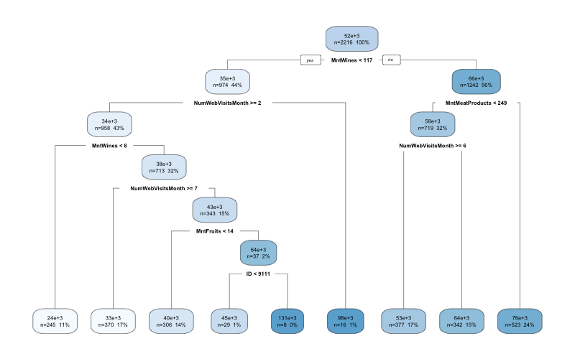
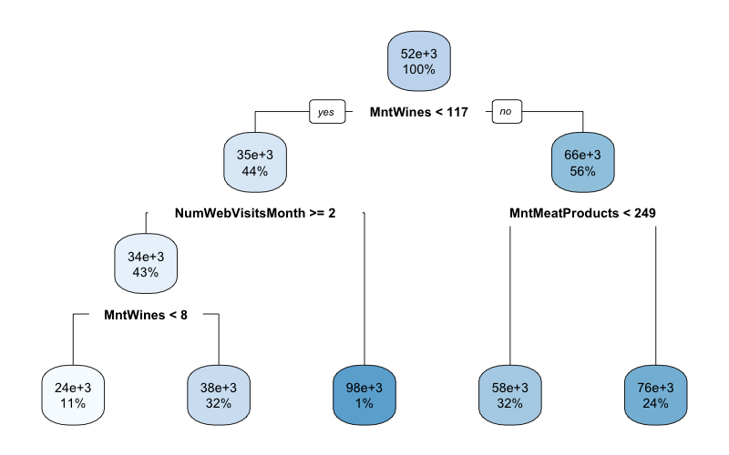
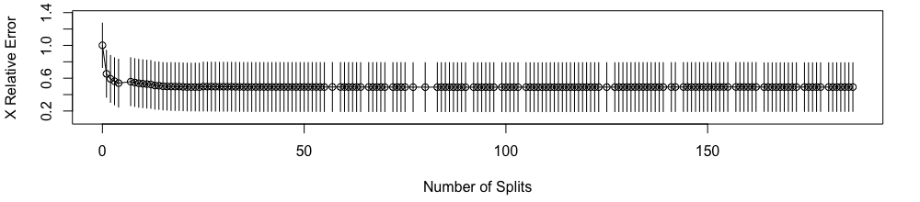
Regression trees

Slide 10
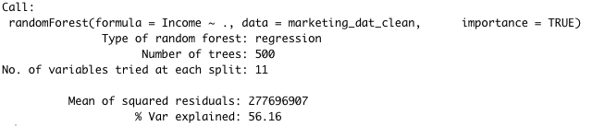
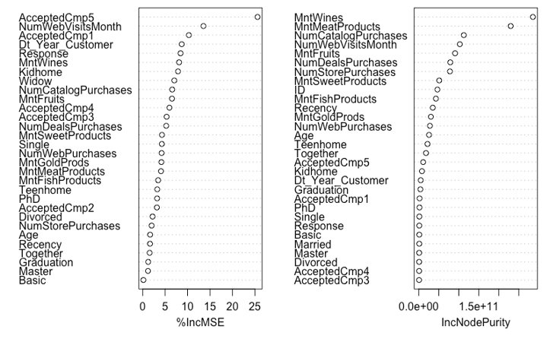
Random forests

Slide 11
Model comparison
Regression tree, Random Forest and Linear regression
Model | RMSE (Goodness-of-fit) | R-squared (% of Variance)
Random Forest | 12657.07 | 0.7550511
Regression tree | 16978.94 | 0.5320547
Linear regression | 13553.14 | 0.7065903

Slide 12
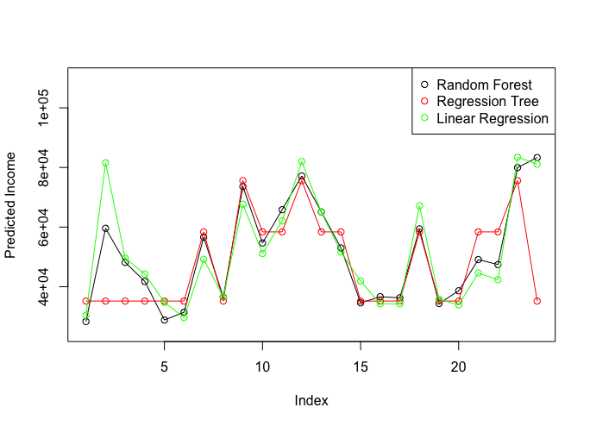
Winning Model
We chose the Random Forests model for the prediction of the missing income values.

Slide 13
Thank you for your attention!

